Slide 1
Software Models

Slide 2
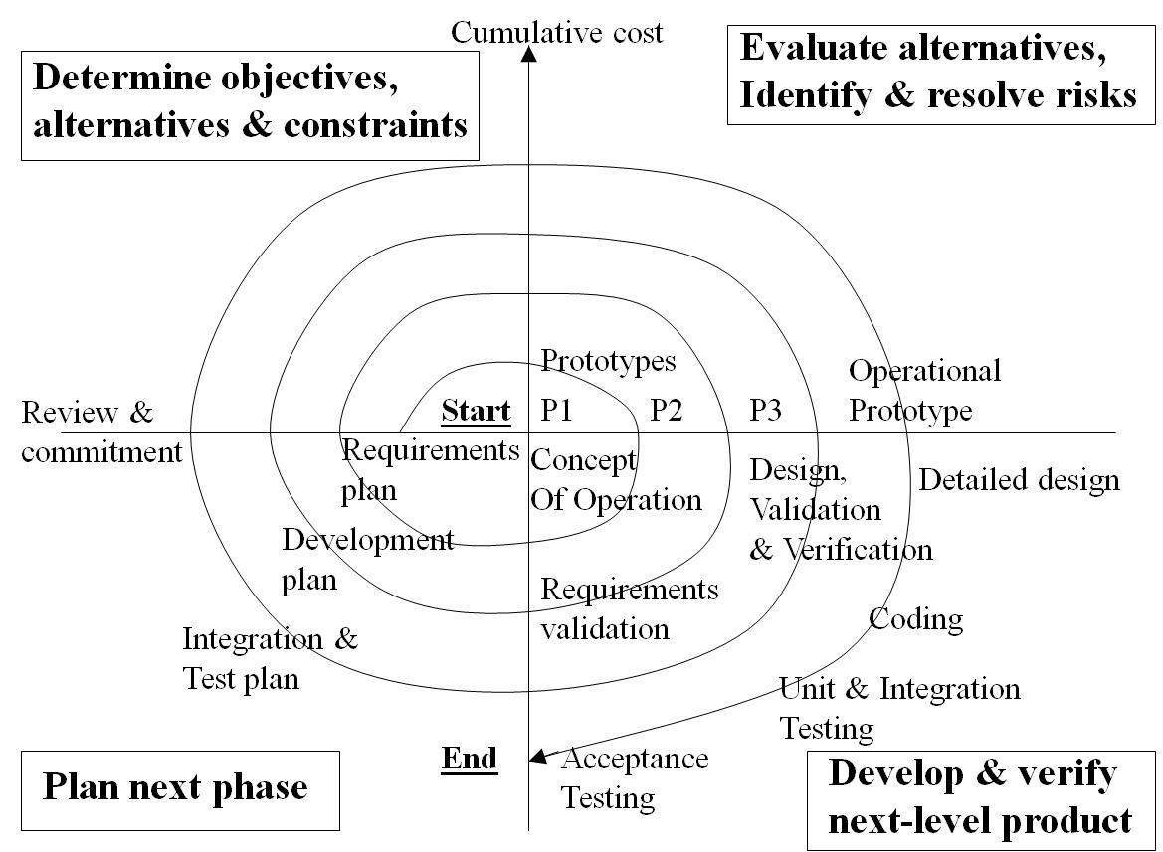
Spiral Model
Since end-user requirements are hard to obtain/define, it is natural to develop software in an experimental way: e.g.
Build some software
See if it meets customer requirements
If no goto 1 else stop.
Notes:
This loop approach gives rise to structured iterative lifecycle models.
In 1988 Boehm developed the spiral model as an iterative model which includes risk analysis and risk management.
Key idea: on each iteration identify and solve the sub-problems with the highest risk.

Slide 3
Boehm’s spiral model
Process is represented as a spiral rather than as a sequence of activities with backtracking.
Each loop in the spiral represents a phase in the process.
No fixed phases such as specification or design - loops in the spiral are chosen depending on what is required.
Risks are explicitly assessed and resolved throughout the process.

Slide 4
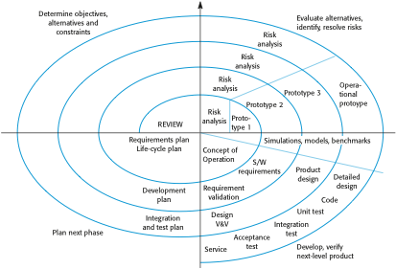
Boehm’s spiral model of the software process

Slide 5
Spiral model sectors
Objective setting
Specific objectives for the phase are identified.
Risk assessment and reduction
Risks are assessed and activities put in place to reduce the key risks.
Development and validation
A development model for the system is chosen which can be any of the generic models.
Planning
The project is reviewed and the next phase of the spiral is planned.

Slide 6
Spiral Model Discussion
Pros
Realism: the model accurately reflects the iterative nature of software development on projects with unclear requirements
Comprehensive model decreases risk
Good project visibility.
Cons
Needs technical expertise in risk analysis to really work
Model is poorly understood by non-technical management, hence not so widely used
Complicated model, needs competent professional management. High administrative overhead.

Slide 7
Process activities
Software specification
Software design and implementation
Software validation
Software evolution
They are organized differently in different development processes. In the waterfall model, they are organized in sequence, whereas in incremental development they are inter-leaved.

Slide 8
Software specification
The process of establishing what services are required and the constraints of the system’s operation and development.
Requirements engineering process
Feasibility study
Is it technically and financially feasible to build the system?
Requirements elicitation and analysis
What do the system stakeholders require or expect from the system?
Requirements specification
Defining the requirements in detail
Requirements validation
Checking the validity of the requirements

Slide 9
The requirements engineering process

Slide 10
Software design and implementation
The process of converting the system specification into an executable system.
Software design
Design a software structure that realises the specification;
Implementation
Translate this structure into an executable program;
The activities of design and implementation are closely related and may be inter-leaved.

Slide 11
Design process activities
Architectural design, where you identify the overall structure of the system, the principal components (sometimes called sub-systems or modules), their relationships and how they are distributed.
Interface design, where you define the interfaces between system components.
Component design, where you take each system component and design how it will operate.
Database design, where you design the system data structures and how these are to be represented in a database.

Slide 12
The software design process

Slide 13
Structured methods
Systematic approaches to developing a software design.
The design is usually documented as a set of graphical models.
Possible models
Sequence model; (Use Case)
State transition model; (Submit, Assign)
Structural model;
Data-flow model.

Slide 14
Programming and debugging
Translating a design into a program and removing errors from that program.
Programming is a personal activity - there is no generic programming process.
Programmers carry out some program testing to discover faults in the program and remove these faults in the debugging process.

Slide 15
The debugging process

Slide 16
Software validation
Verification and validation (V & V) is intended to show that a system conforms to its specification and meets the requirements of the customer.
Involves checking and review processes and system testing.
System testing involves executing the system with test cases that are derived from the specification of the real data to be processed by the system.
Testing is the most commonly used V & V activity.

Slide 17
The testing process

Slide 18
Testing stages
Component or unit testing
Individual components are tested independently;
Components may be functions or objects or coherent groupings of these entities.
System testing
Testing of the system as a whole. Testing of emergent properties is particularly important.
Acceptance testing
Testing with customer data to check that the system meets the customer’s needs.

Slide 19
Testing phases

Slide 20
Software evolution
Software is inherently flexible and can change.
As requirements change through changing business circumstances, the software that supports the business must also evolve and change.
Although there has been a limit between development and evolution (maintenance) this is increasingly irrelevant as fewer and fewer systems are completely new.

Slide 21
System evolution

Slide 22
Key points
Software processes are the activities involved in producing a software system. Software process models are abstract representations of these processes.
General process models describe the organization of software processes. Examples of these general models include the ‘waterfall’ model, incremental development, and reuse-oriented development.

Slide 23
Key points
Requirements engineering is the process of developing a software specification.
Design and implementation processes are concerned with transforming a requirements specification into an executable software system.
Software validation is the process of checking that the system conforms to its specification and that it meets the real needs of the users of the system.
Software evolution takes place when you change existing software systems to meet new requirements. The software must evolve to remain useful.

